Slide 1
SWEN90016 Software Processes & Project Management
SDLC Process
Language Research Case Study
Assignment 1
2019 – Semester 2
Tutorial 2
Copyright University of Melbourne 2017

Slide 2
Today’s aim
Understand the differences between the SDLC and when to use which one

Slide 3
Quiz time
Which of the following are an example of a formal model? Choose all that are correct.
a) V-model
b) Agile
c) Incremental
d) Hybrid
e) Waterfall
A & c & e
from Lecture 2, slide 27

Slide 4
Quiz time
When should you choose a Formal Model?
a) Stable, precise and known requirements
b) Customer gives time to project
c) Mature technologies and tools
d) Client has a prescriptive model established
e) a & c
e
from Lecture 2, slide 27
Notes:
Answer is e

Slide 5
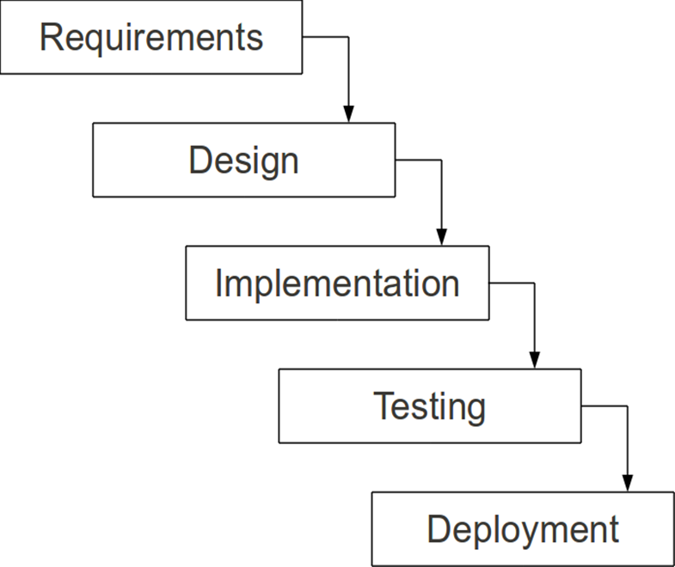
Waterfall
What are the Advantages?
Simple and easy management
Rigid and sequential
Documentation produced
Requirements stable and precise
What are the Disadvantages?
Bad news known late in process
Client feedback known late in process
Discourages change
Documentation not valued
Risks and changes have big impact

Slide 6
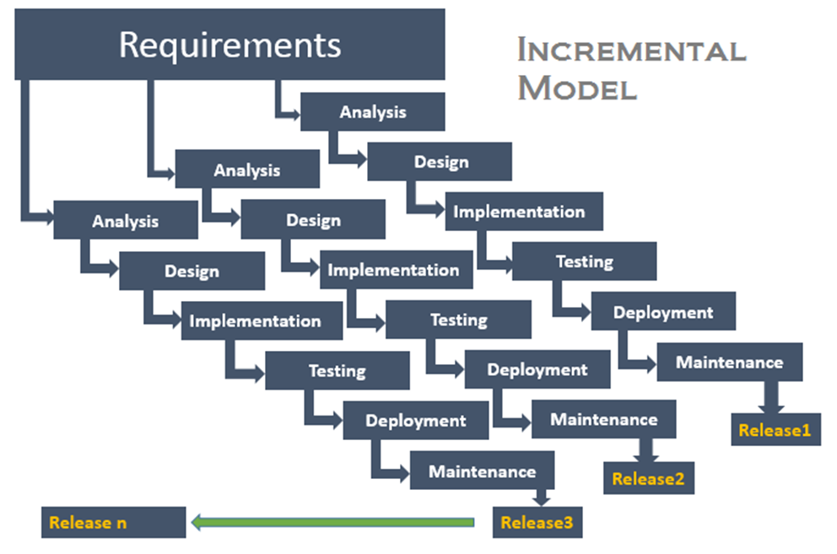
Incremental
Requirement - partition into segments
Releases - mini waterfall process
Integrate modules
What are the Advantages?
Smaller, easier modules
Initial modules released earlier
Client feedback known earlier
Change has less impact
Requirements stable and precise
What are the Disadvantages?
Management complexity
Increased cost
Partition skill
Integration risk
Rigid within each partition

Slide 7
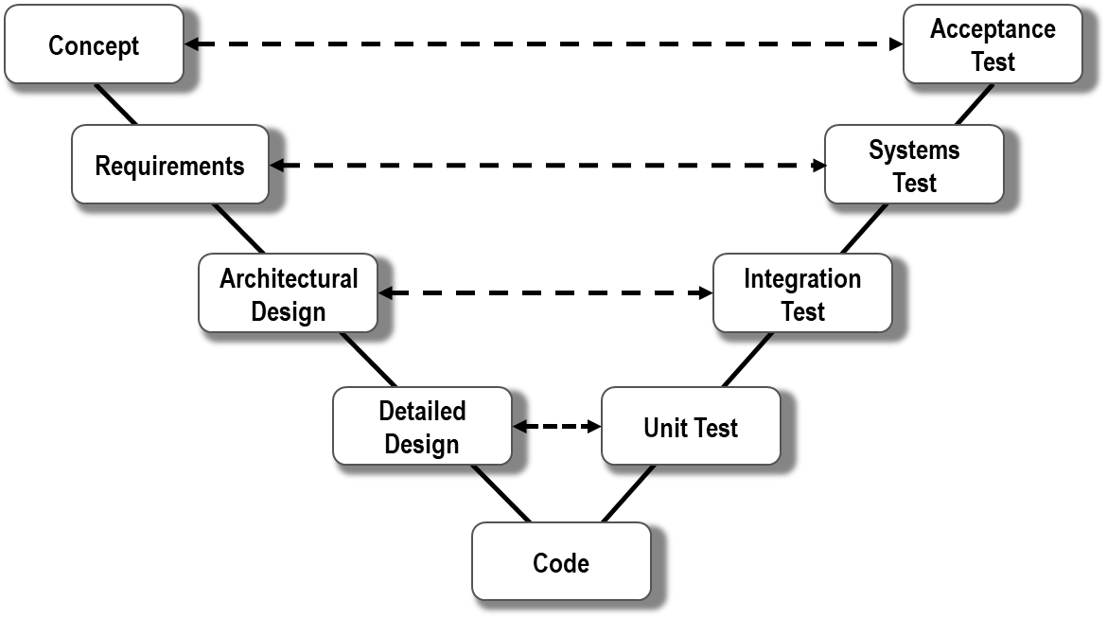
V-Model
waterfall model plus defined artifact deliverable
development stage ← → testing phase
What are the Advantages?
Simple and easy management
Rigid and sequential deliverable
Documentation produced
Requirements stable and precise
What are the Disadvantages?
Requires discipline
Bad news known late in process
Client feedback known late in process
Discourages change
Test artifacts are expensive
Risks and changes have big impact

Slide 8
Quiz time
When should you choose agile?
a) Requirements continue to emerge
b) Customer gives time to project
c) Mature technologies and tools
d) Change is welcome
e) a & b & d
e
from Lecture 2, slide 27

Slide 9
Agile
Scrum: method to organize working teams
XP: method to improve code quality
What are the Advantages?
Transparent productivity due to fast releases
Focus on client satisfaction
Embraces change
Requirements emerge
Efficient and simple code
What are the Disadvantages?
Requires experience of ceremonies
Requires teamwork skills
Giant “TODO” list lacks design overview

Slide 10
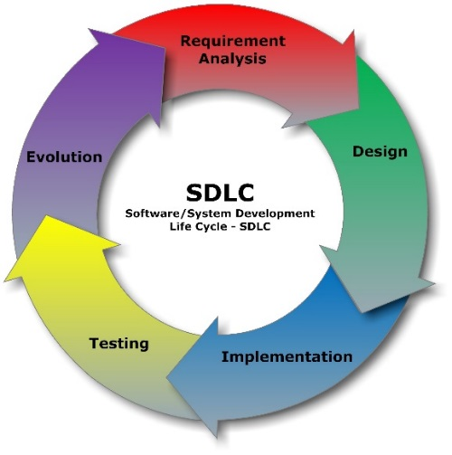
Compare SDLCs
When to choose Formal Models?
Customer knows what they want at the start
Stable, precise and known requirements
Change is not expected
Mature technologies and tools
When to choose Agile Models?
Customer gives time to project
Requirements continue to emerge
Change is welcome
When to choose a hybrid model?
Client has a prescriptive model established
from Lecture 2, slide 27

Slide 11
Today’s aim
Explore the relationship between projects and processes
A “process” is a repetitive sequence of tasks and the tasks are known at the outset since it is repetitive.
The sequence of tasks in a “project” is not normally repetitive and may not be known at the outset of the project.
A “process” is generally ongoing and doesn’t normally have an end.
A “project” has a beginning and an end (although the beginning and end may not be well-defined when the project starts and the end might be a long time in the future).

Slide 12
Planning Phase
The second Project Management process: planning
from Lecture 2, slide 16 & 17
Approach:
team resources & structure,
project goals & characteristics
Processes:
formal or agile SDLC phases
Activities:
Formal: Requirements Analysis, or
Agile: Groom Product Backlog
Decompose the plan!
marks given in assignment when you identify the SDLC phase names and specify which activities belong in this phase
Tools:
hardware, operating system
programming languages, libraries,
network, ecosystem, IDEs

Slide 13
Case Study Analysis
Case Study 2 –Language Research Tool Project
Determine the goals & key characteristics
Goal
Efficient, open & published language learning
Cultural preservation
Key Characteristics
Data centric, data integrity, data sharing
Complex privileges & roles
Global, distributed, interoperable

Slide 14
Case Study Analysis
Case Study 2 –Language Research Tool Project
What are the challenges and risks?
Challenges: what would make this project difficult?
integrated, trust-worthy, searchable data
Risks: what could make this project fail?
poor quality data and duplicate data silos

Slide 15
Project Analysis
In groups of 4, discuss SDLC processes & activities
Consider the project, people & technology
Evaluate the team and project constraints.
Evaluate multiple SDLC models
Identify the advantages and disadvantages
Consider the outcomes and risks
Justify an effective SDLC process
Defend your choice of SDLC
List the activities done
Formal: Requirements Specification
Agile: Product Backlog

Slide 16
Assignment 1
Marks: 20%
What: Figure out an appropriate SDLC for a given Case Study
How to do well:
Critical analysis of Case Study characteristics and risks
Critical analysis of each SDLC’s processes
Balance the pros and cons and justify your choice of SDLC
Any Questions?
next tutorial: Agile Scrum SDLC

Slide 17
Thank You!

